Slide 1
Medisoft – officePay - Demo

Slide 2
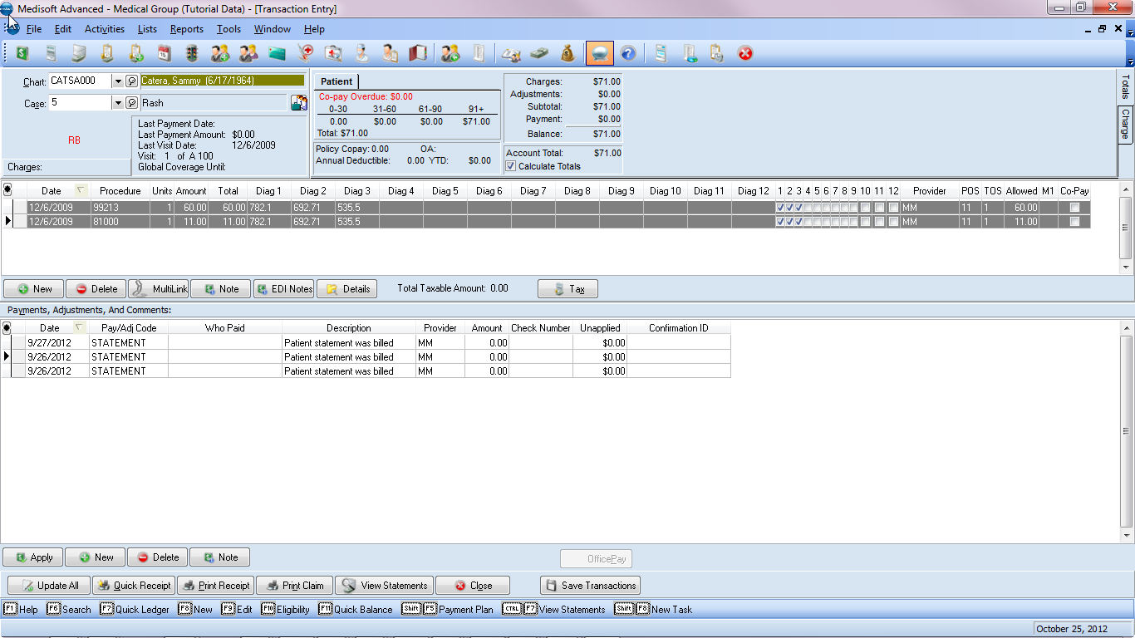

Slide 3
Select “New”

Slide 4
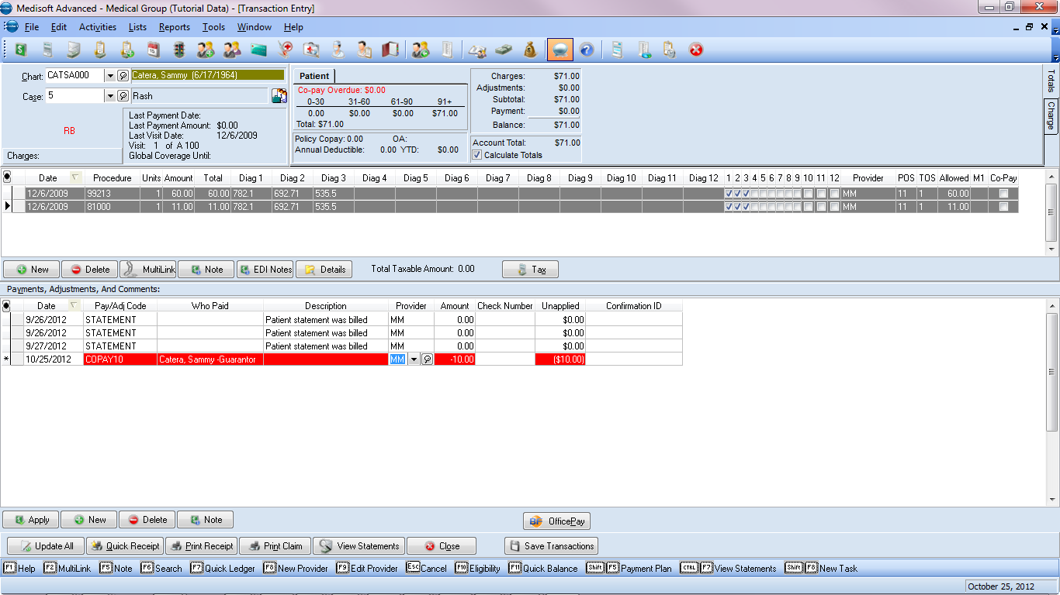
Enter Payment Code, Activates OfficePay button

Slide 5
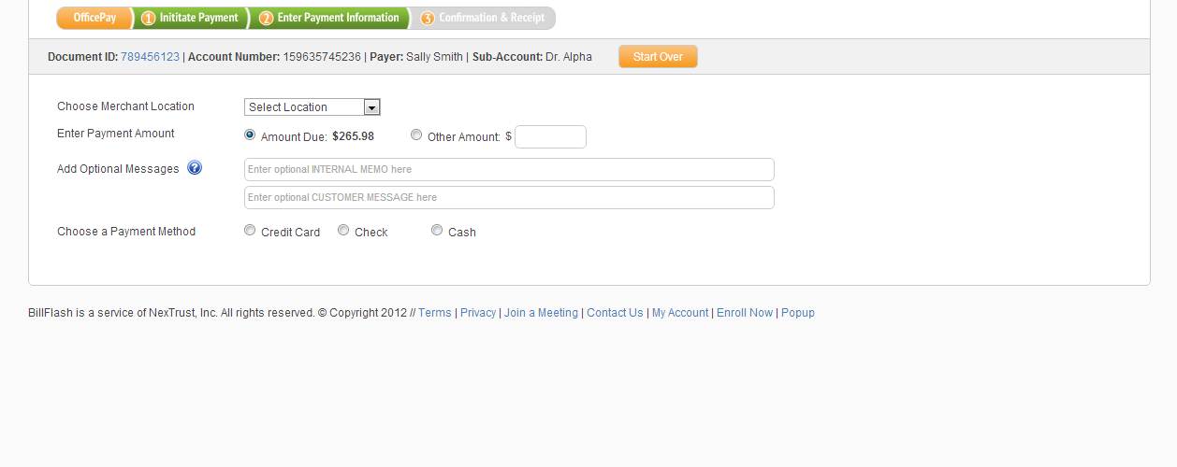
Select Payment Method

Slide 6
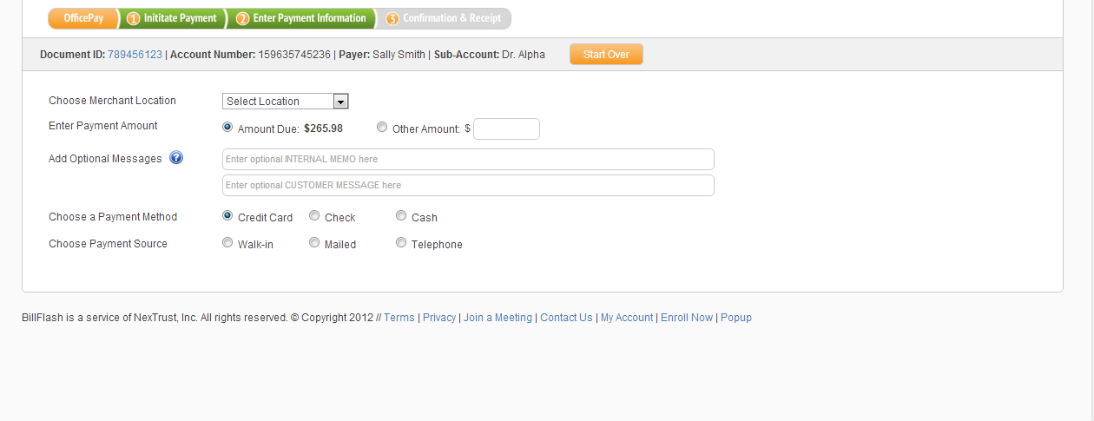
Select Payment Method

Slide 7
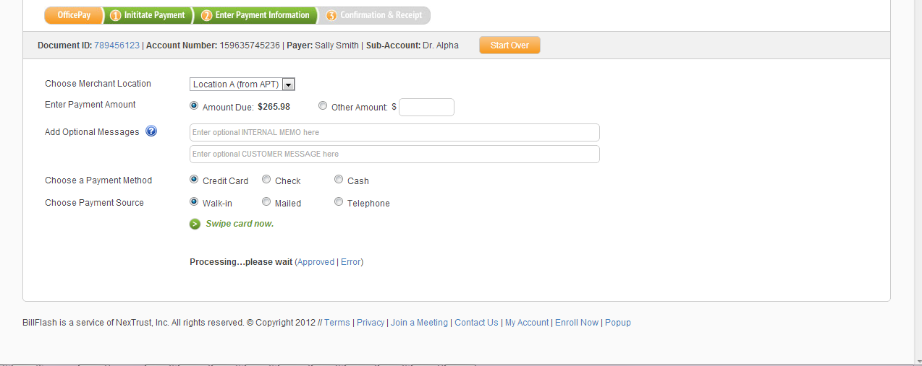

Slide 8
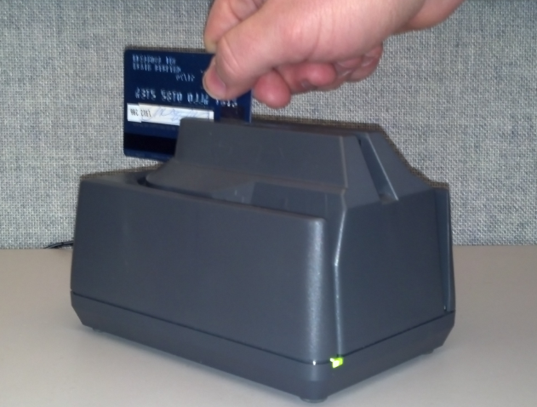
******

Slide 9
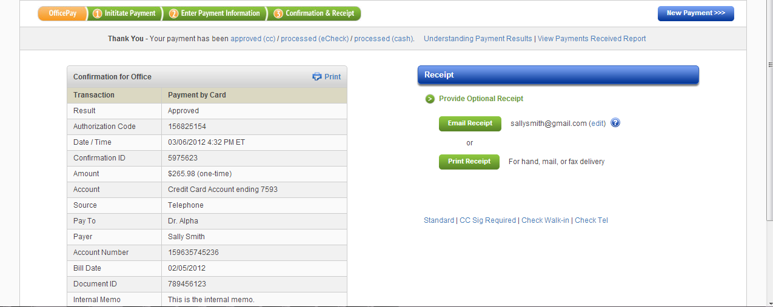

Slide 10
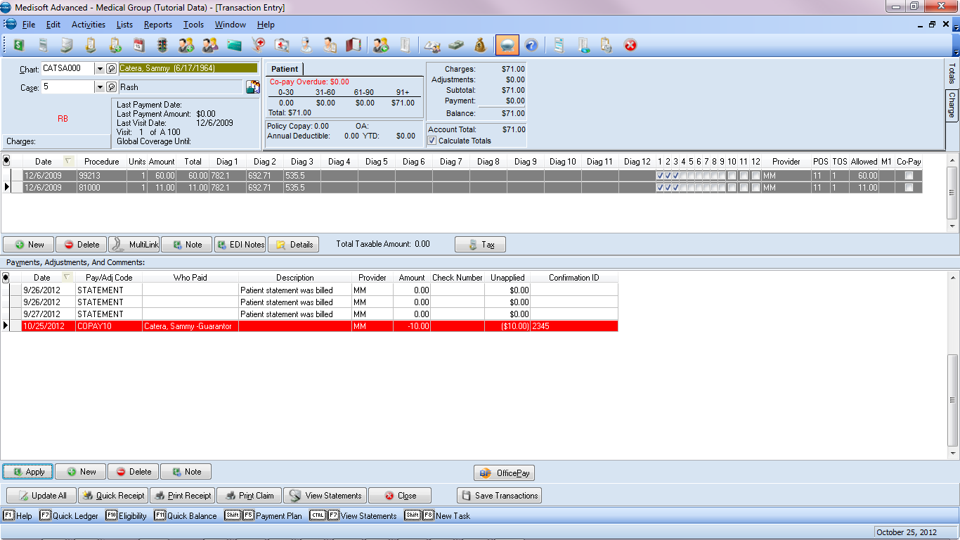
Confirmation ID, showing reconciliation

Slide 11
Office Pay can be launched from 3 locations in Medisoft:
Transaction Entry
Deposit List
Office Hours

Slide 12
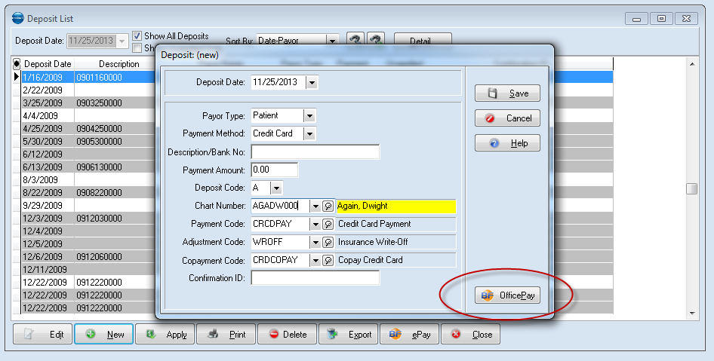
OfficePay – Deposit List

Slide 13
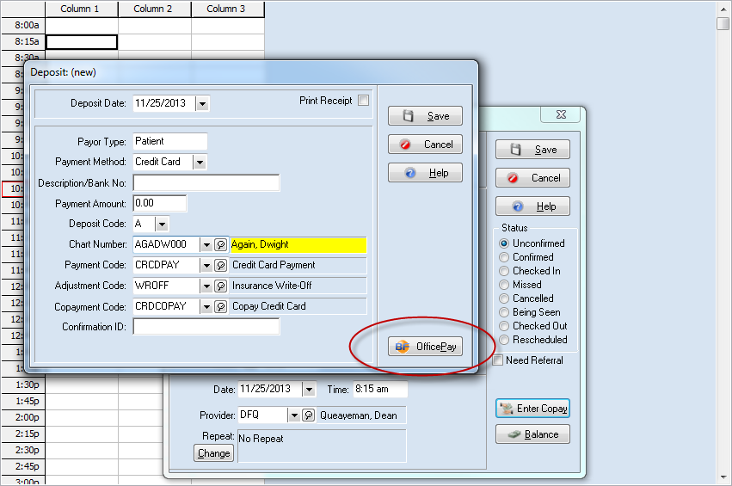
OfficePay – Office Hours

Slide 14
Medisoft – ePay - Demo

Slide 15
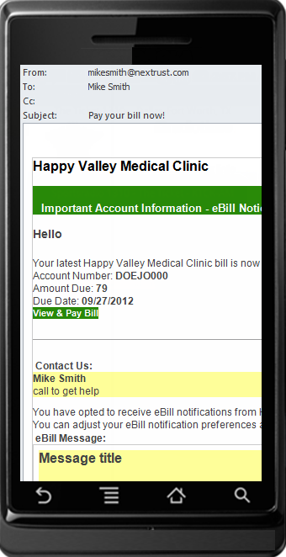
Patient receives message to pay bill from an eBill notification or mailed statement.

Slide 16
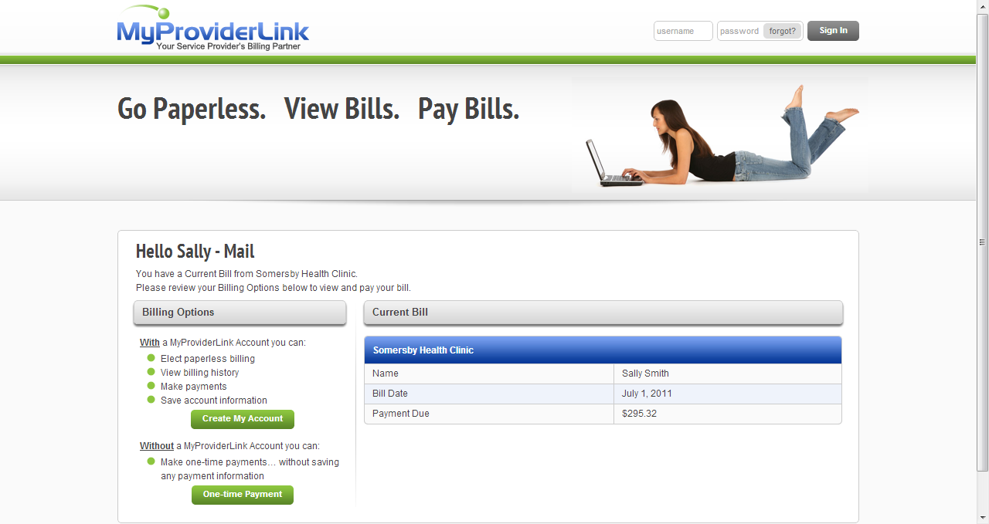
Select Billing Options

Slide 17
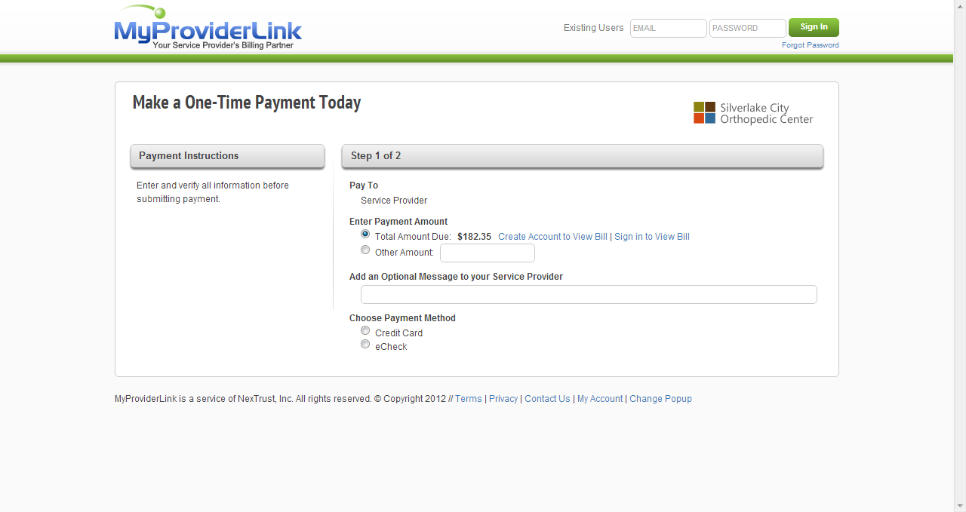
Select Payment Amount, Message to Provider, and Payment Method

Slide 18
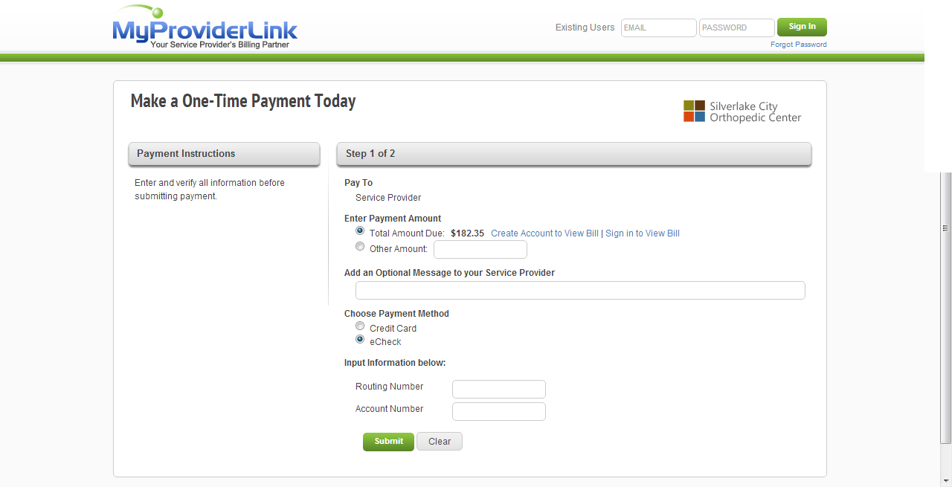

Slide 19
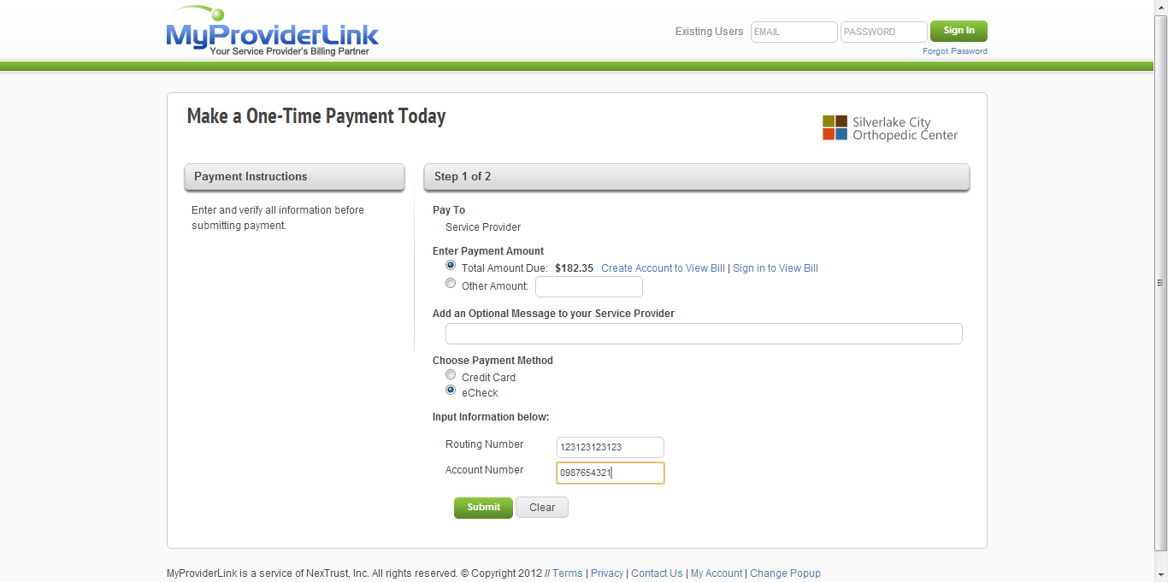
Enter eCheck information, and select submit

Slide 20
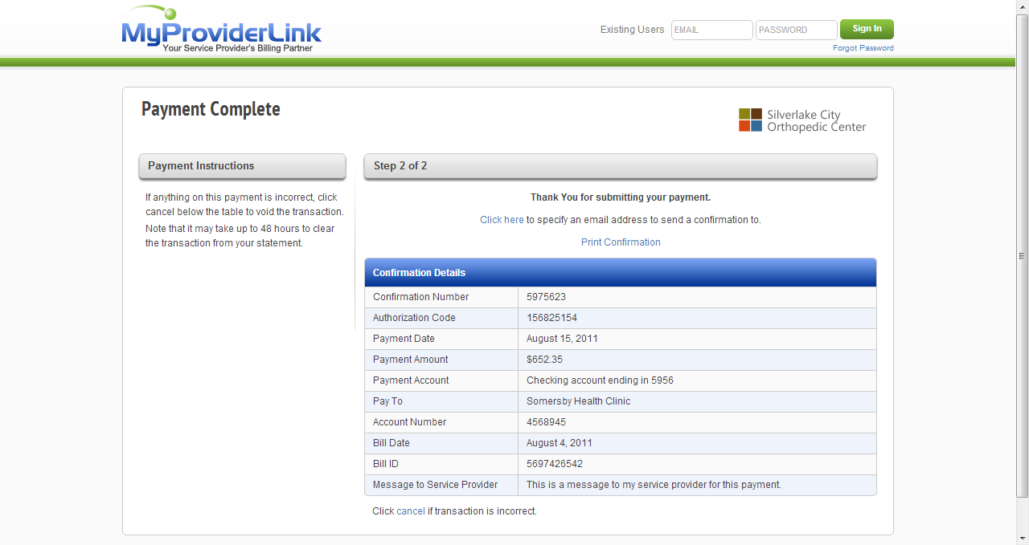
Confirmation page or “Receipt”

Slide 21
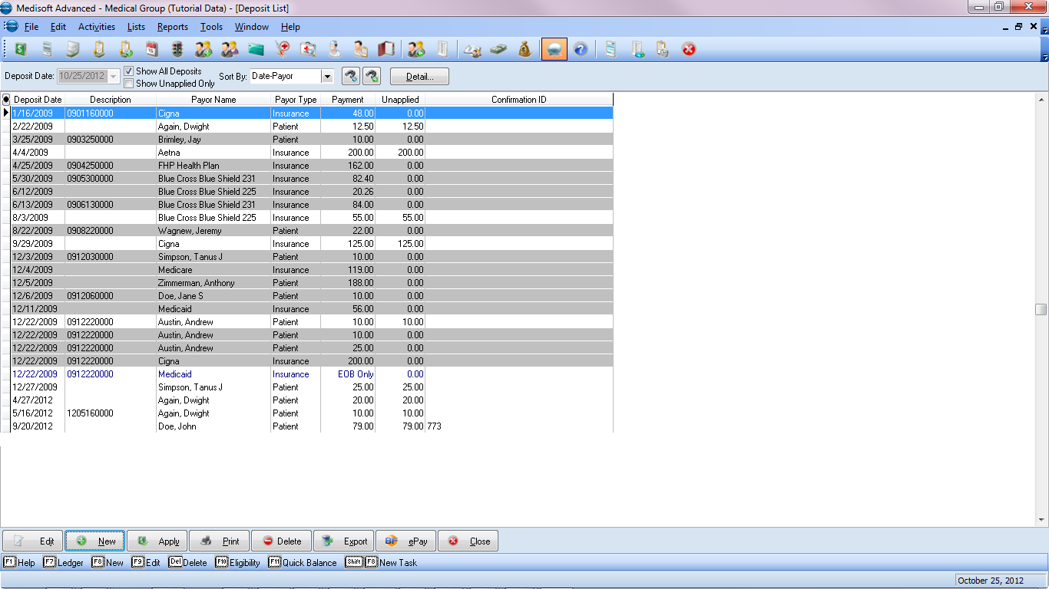
BillFlash ePay button, pulls in payment transactions from MyProviderLink.com

Slide 22
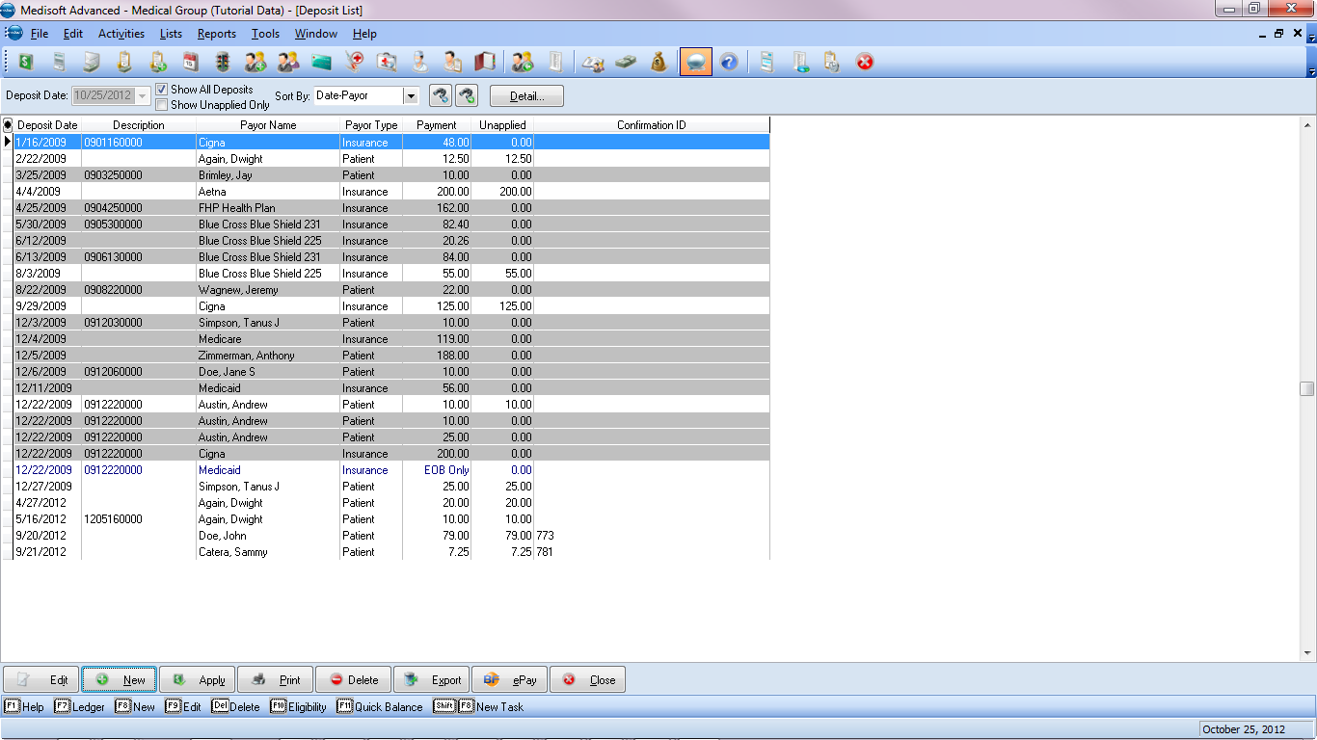
Payment pulled in with Confirmation ID. Payment can now be applied.

